Slide 1

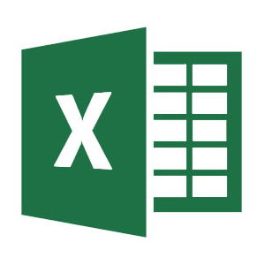

Importing Excel and CSV Files into R Script
Prof. Dee Chiluiza, PhD
CPS. Northeastern University

Slide 2
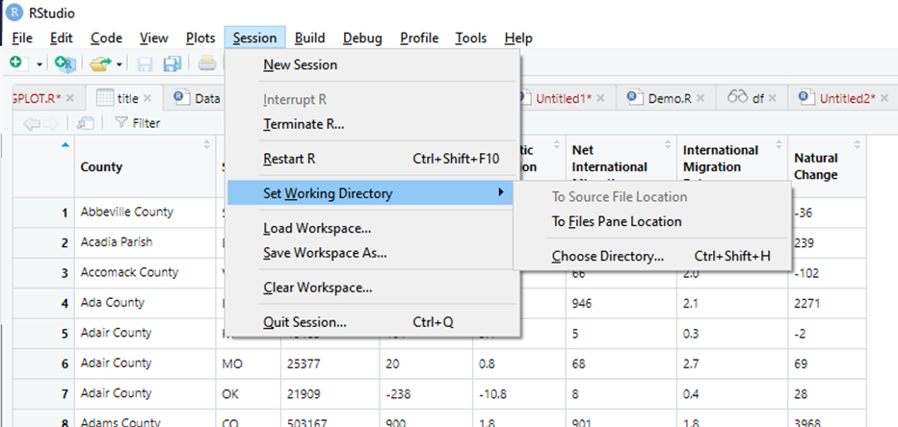

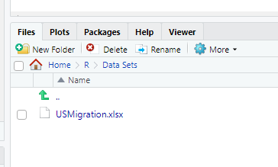
There are several ways to import data sets, this is my favorite and, in my opinion, the easiest.
In R studio, first set the working directory of your preference. I create a Folder named R under Documents, then a folder named Data Sets.
Go to: Session, then to Set Working Directory.
This can be different for every project you create.
Every time that you add any folder or file inside the Working Directory (like any regular file under Windows Explorer), all those files will also appear on R Studio under the Files section.
Add your Excel or CSV files into that folder using Windows Explorer.
Folder localization path

Slide 3
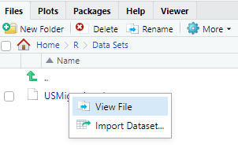
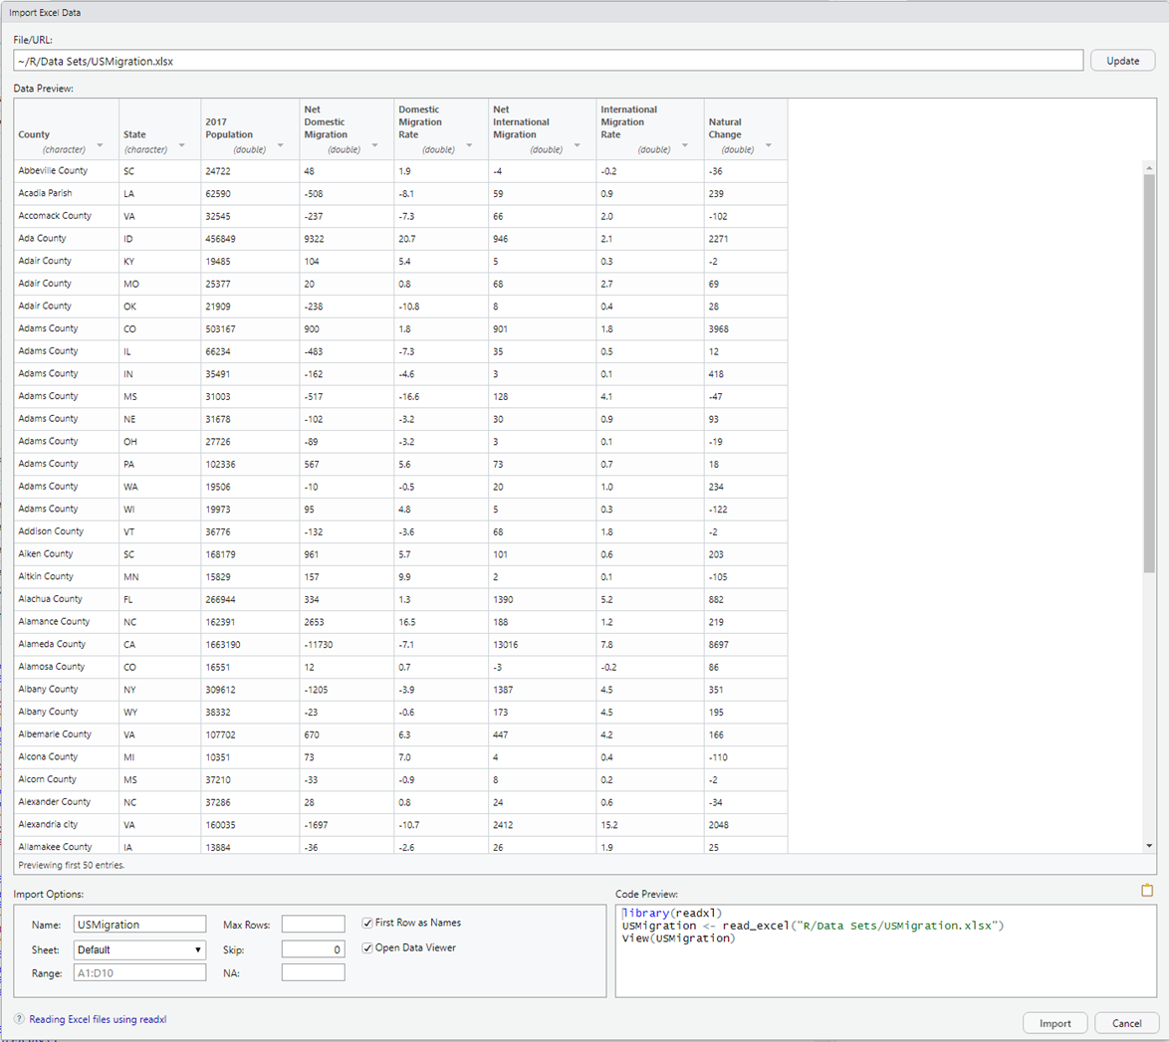
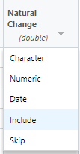
1
Using R Studio, go to Files then click on the file you want to import, then on Import Dataset…
1. Make sure your variables have the correct type.
2. You can change the name of your data set.
3. If your files contains several tabs, select the tab you want to import.
4. If you don’t want to import all the data, you can indicate the range of data to import.
2
3
4
5

Slide 4
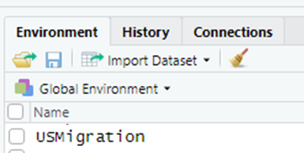
1. Make sure your variables have the correct type.
2. You can change the name of your data set.
3. If your files contains several tabs, select the tab you want to import.
4. If you don’t want to import all the data, you can indicate the range of data to import.
5. If you have missing values such as “*” or “#”, indicate it here.
6. You don’t need to copy the code, but try to understand what the program is doing.
7. Click Import, now your file will appear under the Environment window.
1
And you’re done with this step.
Then you can call the file by typing its name in the console, it’s ready for use.
2
6
3
4
5
7

